Slide 1

Detecting Credit Card Fraud
A Comparative Analysis of Machine Learning Models
By
Aishani Mittal (S24CSEU1545)
Harsh Renose (S24CSEU2872)
Harsh Kumar (S24CSEU1575)

Slide 2


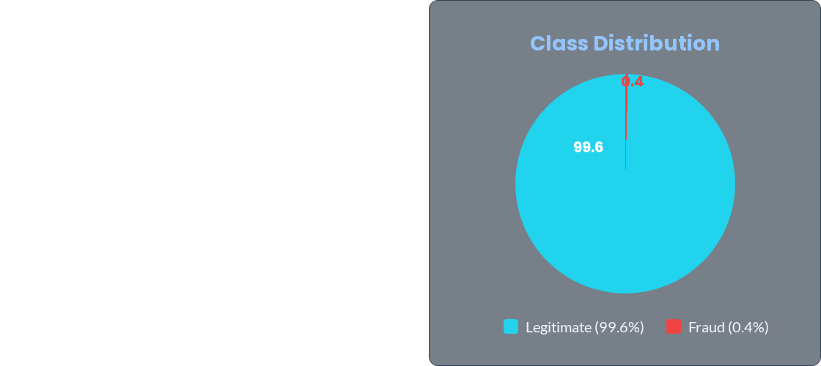
The Problem: Extreme Imbalance
The Class Imbalance Challenge
Accuracy is useless. Predicting "no fraud" gives 99.6% accuracy but catches nothing.
Goal: Maximize F1-score, not accuracy.

Slide 3

The Data & Preprocessing Pipeline
Raw Data
1.8M transactions with timestamps, amounts, merchant categories, and user demographics
Feature Engineering
Create age from DOB, extract hour/weekday from timestamp, calculate distance from home
Dual Processing Pipelines
Linear: StandardScaler + OneHotEncoder | Tree: OrdinalEncoder (no scaling)
Resampling Strategies
Upsampling (df_up): duplicate fraud samples | Downsampling (df_down): reduce legit samples

Slide 4
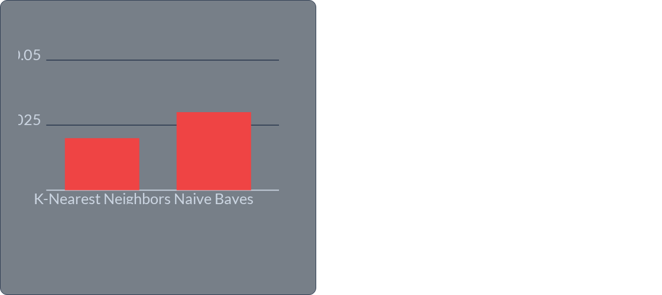

Baseline Failure: KNN & Naive Bayes (F1 < 0.05 )
Why They Failed:
•
KNN: Victim of the Curse of Dimensionality—25 features make distance meaningless.
•
Naive Bayes: Assumes all features are independent (they aren't).

Slide 5
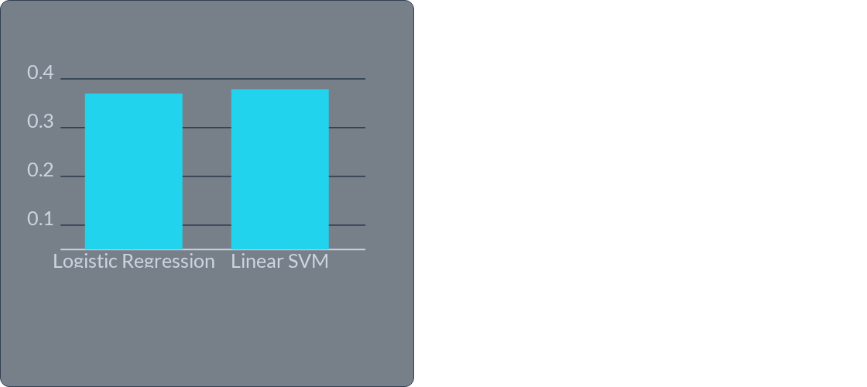
The Linear Baseline (F1 ≈ 0.37 )
Interpretation:
These models provide a clean, interpretable baseline. They are limited by linear separability—fraud patterns are highly non-linear.

Slide 6



Decision Trees: Overfitting vs. Generalization
F1 Score Comparison
•
Full Depth Tree: 0.46—memorizes training set with unrestricted growth
•
Pruned Tree: 0.56 - Depth=10 forces generalization, 10-point improvement
Insight
Unrestricted trees memorize the training set. Pruning limits depth, forcing the model to generalize.
Lesson: Simplicity beats memorization.

Slide 7
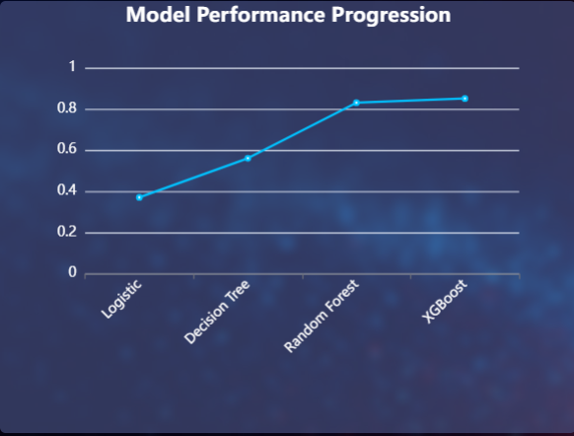
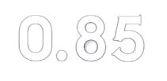
Advanced Architectures: Random Forest & XGBoost
Key Insight:
Ensembles combine many weak trees to form powerful learners, reducing variance and fixing overfitting
XGBoost F1 Score

Slide 8
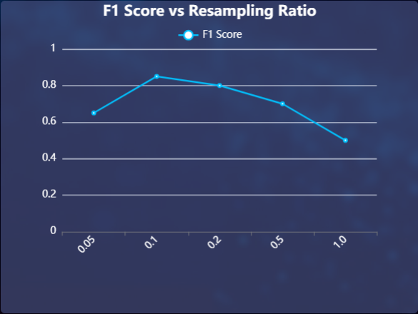
The Winning Strategy - Ratio
Optimizing the Resampling Ratio
The curve peaks at ratio=0.1 ﻿﻿﻿﻿﻿﻿﻿﻿﻿and then collapses. All-in upsampling overfits to fake data
Best balance: ratio=0.1
Controlled balance beats brute force

Slide 9
Impact of Sampling Techniques on Model Performance
Model | Dataset | F1 Score
XGBoost | df_down (Downsampling) | 0.63
XGBoost | df_up (Upsampling) | 0.85
Insight:
•
Downsampling throws away valuable legitimate data, confusing the model.
•
Upsampling gives the model more fraud examples to learn from.
Takeaway: Complex models thrive on more (balanced) data.

Slide 10
Conclusion & Demo
Final Model Configuration & Results
•
Model: XGBoost
•
Sampling: 'df_up' (Upsampling)
•
Ratio: 0.1
•
Final F1 Score: 0.851
Final Thoughts
•
Resampling & feature engineering matter as much as model choice.
•
Boosted ensembles dominate when tuned properly.
•
Fraud detection is about balance, not brute force.

